Slide 1
4.3.2 Tree-Traversal
Syllabus Details
4.3.2 Tree-traversal
4.3.2.1 Simple tree-traversal algorithms
4.3.2 Tree-Traversal
Starter
Join the term to the definition.
What is a tree?
A tree is a non-linear data structure where the nodes are connected by a directed edge.
A graph can consist of cycles; that is, two child nodes may be connected to each other. In trees, the connection is directed from a parent to its child nodes only.
What is the difference between a tree and a graph?
A tree where each node has a maximum of two child nodes is called a binary tree.
What is a binary tree?

Slide 2
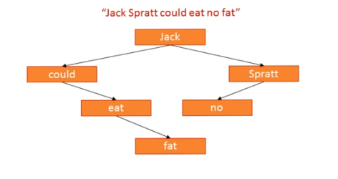
Key concept
Tree traversal
Traversal of a tree means to visit each node of the tree in some order.
Key concept
Binary Tree
A binary tree is a data structure consisting of nodes and pointers. It is a special case of a graph where each node can only have zero, one or two pointers, Each pointer connects to different node.
The first node is known as the root node. The connected nodes are known as child nodes, while the nodes at the very bottom of the structure are referred to as leaf nodes.
In the below example, Jack is the root node, could, Spratt and eat are child nodes and no and fat are leaf nodes.
How would this binary tree be represented in memory with dictionaries?
{“Jack”:[“Spratt”, “could”], “Could”:[“eat”], “eat”:[“fat”], “Spratt”:[“no”]}

Slide 3
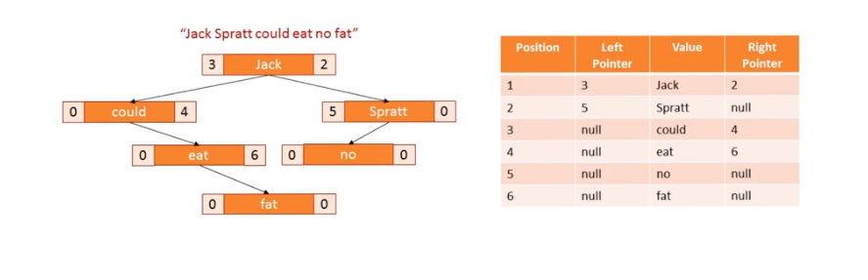
Key concept - continued
.It is more common to see a binary tree represented as objects consisting of a node with a left and right pointer.
Applications of a binary tree
Binary trees have many uses in computer science. These include database applications where efficient searching and sorting is necessary without moving items, which is slow to execute. They can also be found in wireless networking , router tables and scheduling processes in operating systems. Implementations of A* pathfinding algorithm can use trees. Huffman coding used for compression algorithms such as jpeg and mp3 makes use of binary trees, as does cryptography (GGM trees).
Support
PGonline - Section 7 p 212
LMC - Paper 1 theory p145
Craig N Dave
Video 1 Video 2

Slide 4
Task one - Operations on a binary tree
There are a number operations that can be performed on a binary tree.
Complete the table.
Operation | Description
Add | adds a new node to the tree.
Delete | Removes a node from a tree
Binary search | Returns the data stored in a node
Pre-order traversal | Type of DFS
In-order traversal | Type of DFS
Post-order traversal | Type of DFS
Breadth-first search | Traverses the tree and returns the data stroed in a node
E
B
G
A
C
F
H

Slide 5
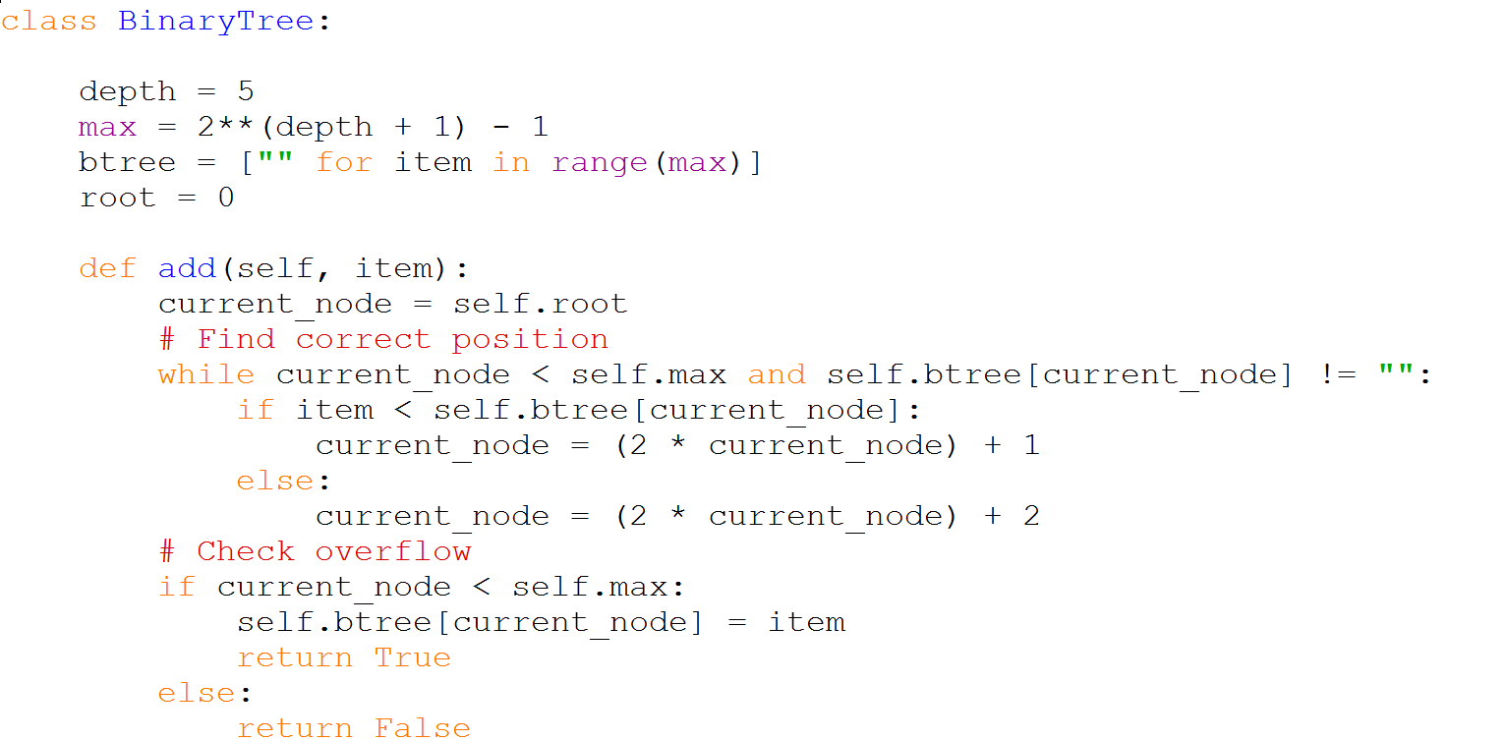
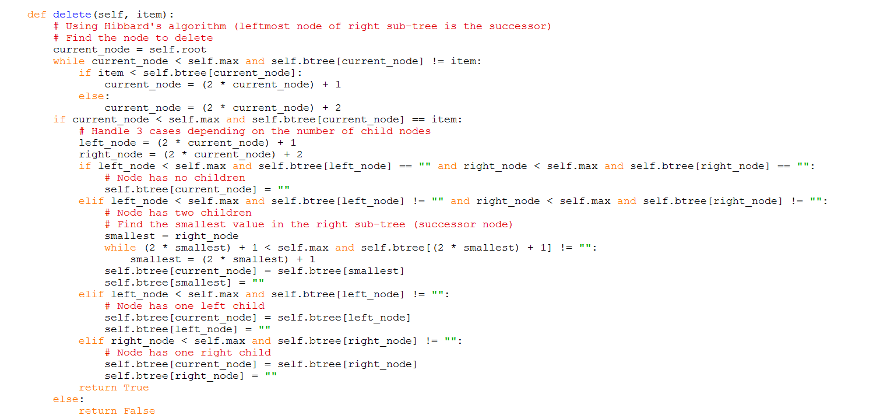
Task two - Binary Tree code using an Array/List

Slide 6
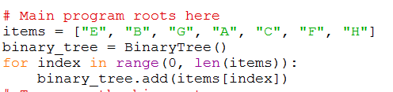
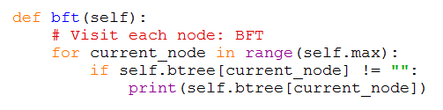
Task two - Binary Tree code using an Array/List
Using the initial list and code below draw the binary tree in the space.
Now add another letter D and use the below code to check if has placed in in the correct place.
Now return to the original binary tree and remove A and check using the code above.
What has happened to the tree?
E
B
G
A
C
F
H

Slide 7
Task two - Binary Tree code using an Array/List
Now return to the original binary tree and remove B and check using the code above. What has happened this time and why?
Practical
Alter the code given to you so that it can search the graph shown below.

Slide 8
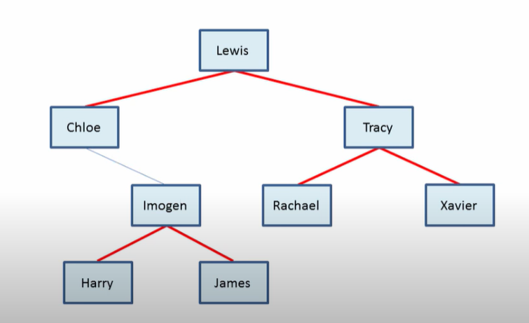
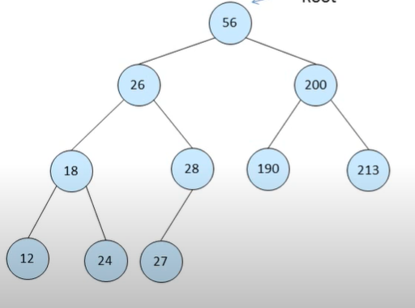
Practical
Alter the code given to you so that it can search the graph shown below.
Practical
Alter the code given to you so that it can search the graph shown below.

Slide 9
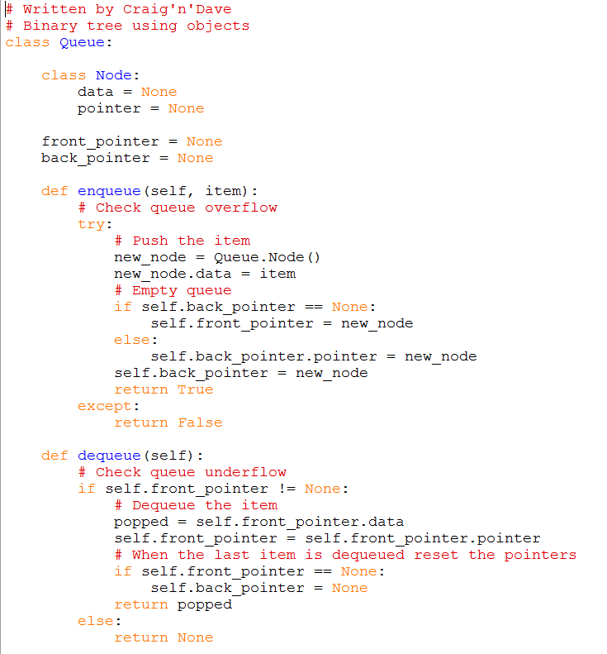
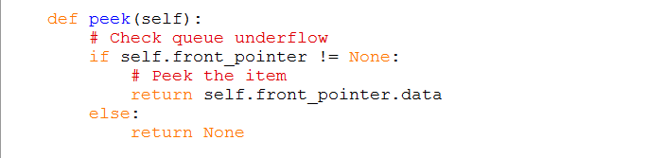
Task two - Binary Tree code using objects

Slide 10
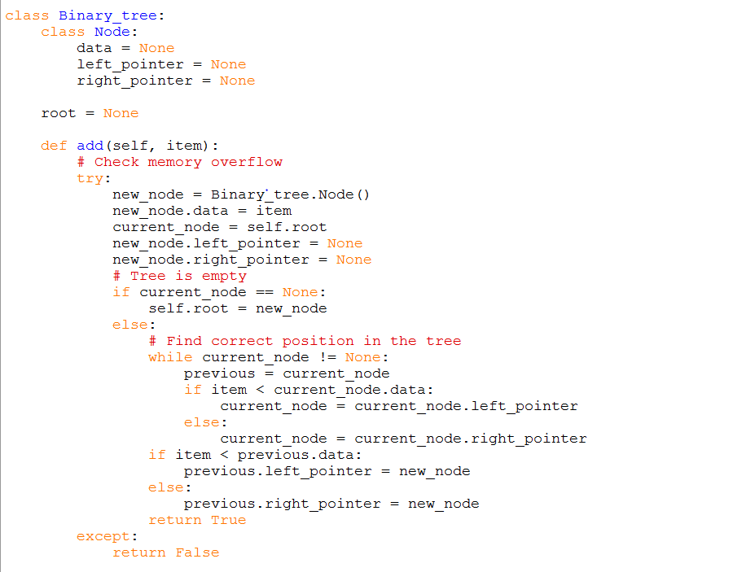
Task three - Binary Tree code using objects

Slide 11
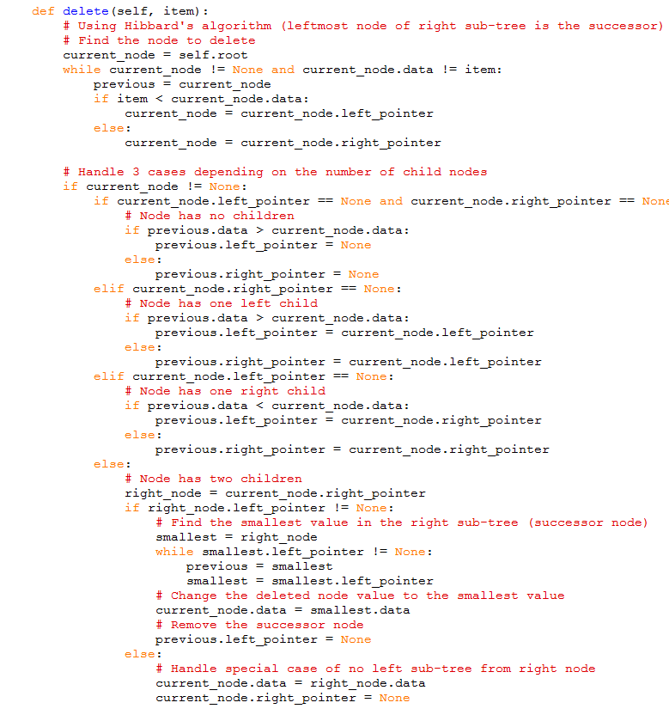
Task three - Binary Tree code using objects

Slide 12
Task three - Binary Tree code using objects
Look at the two versions of creating a binary tree. Write down the differences between the two pieces of code.
Practical
Now use the examples from the array version in your object version.

Slide 13
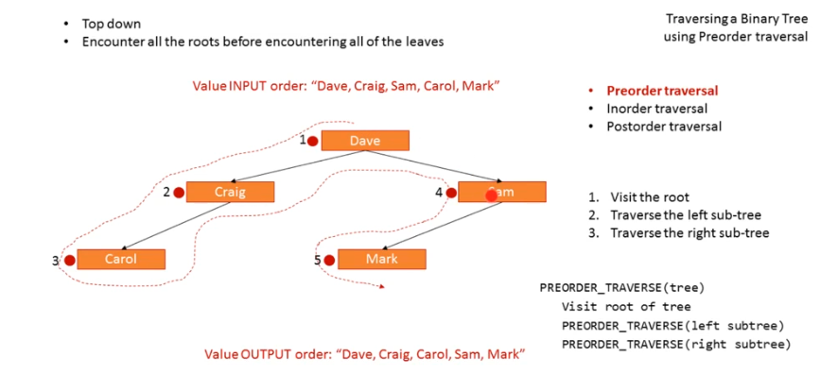
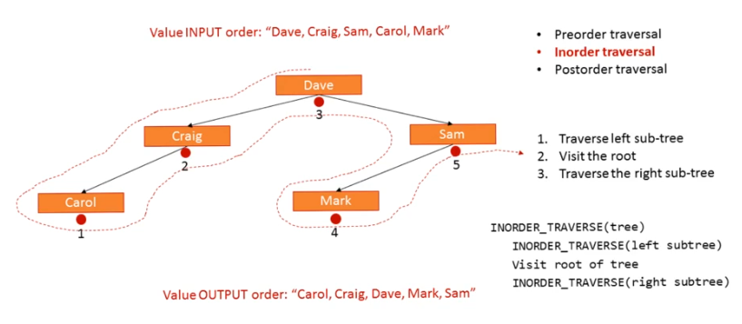
Key concept - Binary tree Depth -first traversal
For binary trees there are three principle ways of traversing the tree:
Pre-order traversal
In- order traversal
Post-order traversal

Slide 14
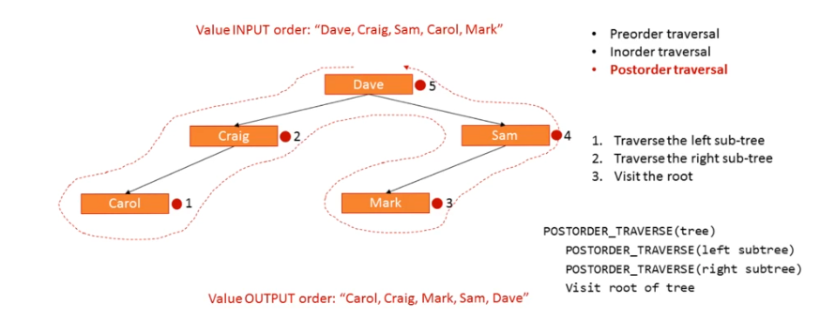
Key concept - Binary tree Depth -first traversal
For binary trees there are three principle ways of traversing the tree:
Pre-order traversal
In- order traversal
Post-order traversal
Support
PGonline - Section 8 p 225
LMC - Paper 1 theory p145
Lucid Programming You tube
Video 1
William Fiset You tube
Video 1

Slide 15
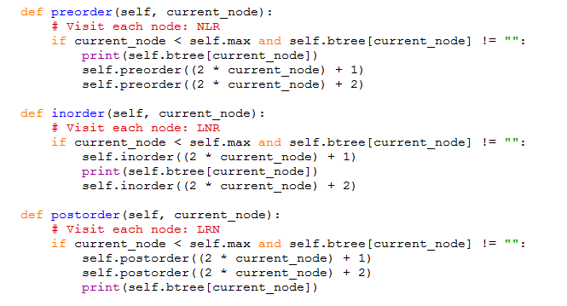
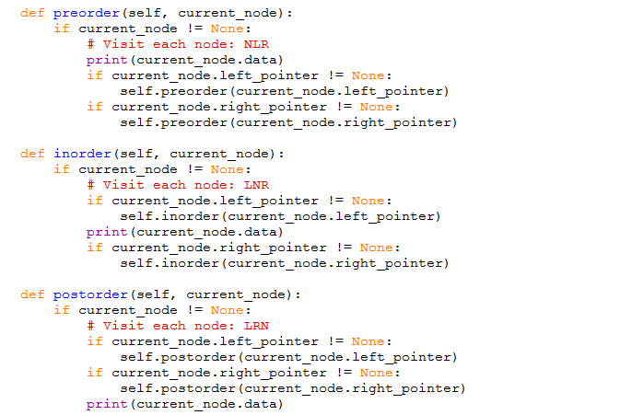
Task four
Identify which code relates to the Arrat/List version and which one to the object version.

Slide 16
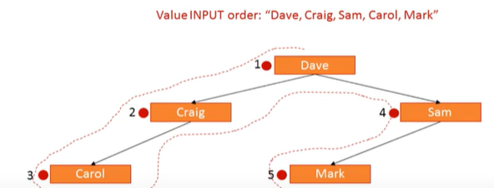
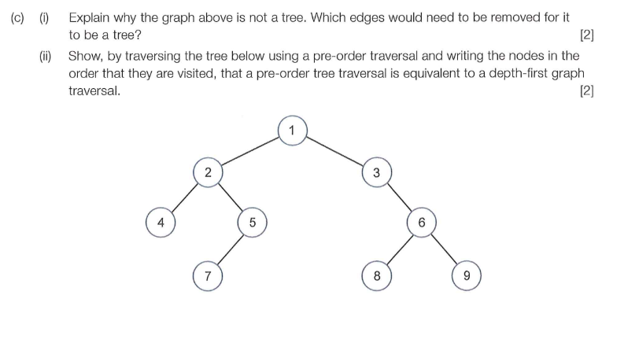
Practical
Now both versions of code with the below binary tree and check the three different traversals.
Now try them using the numbers below.
36,21,100,6,34,78,178
Exam style question
124573689

Slide 17
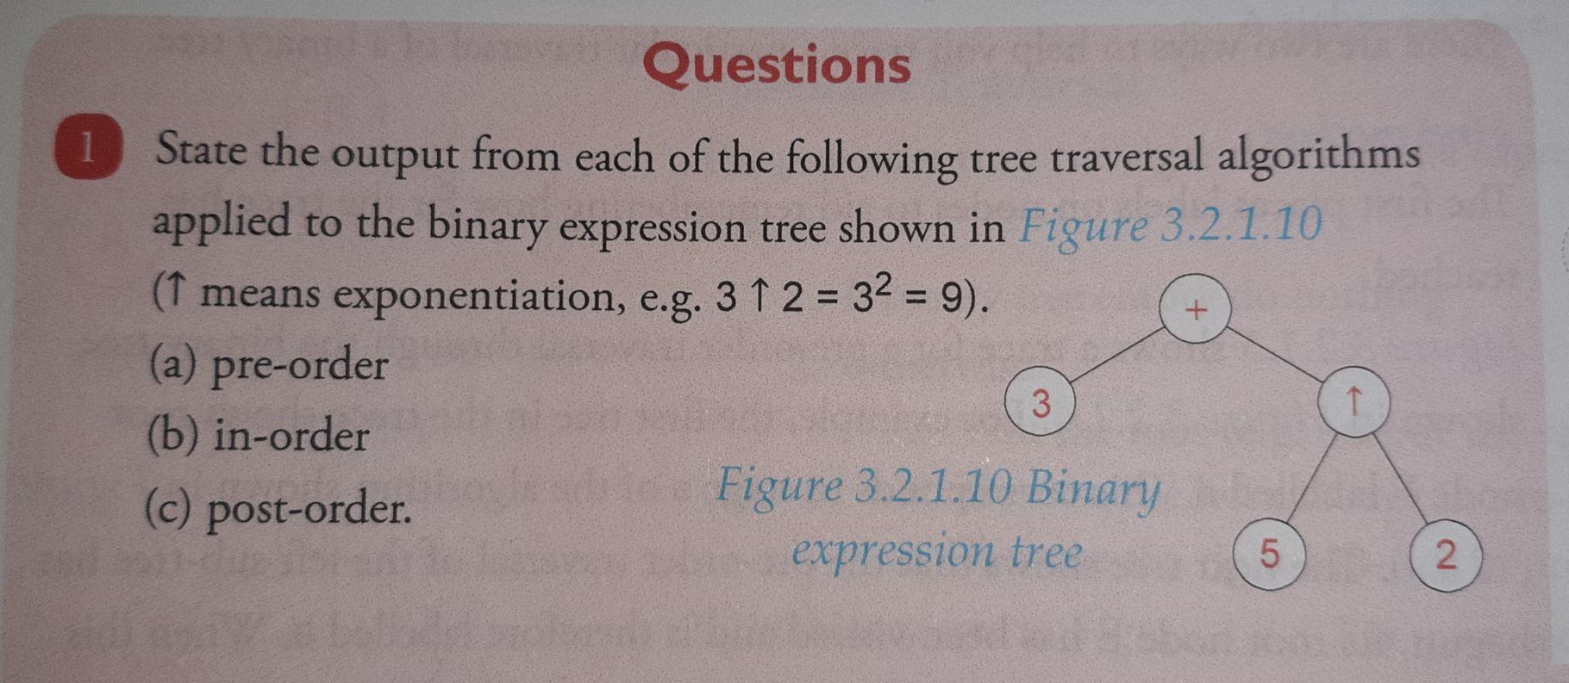
Questions
+3^52 = 6.461081889226673e24
3+5^2 = 28
+^253

Slide 18
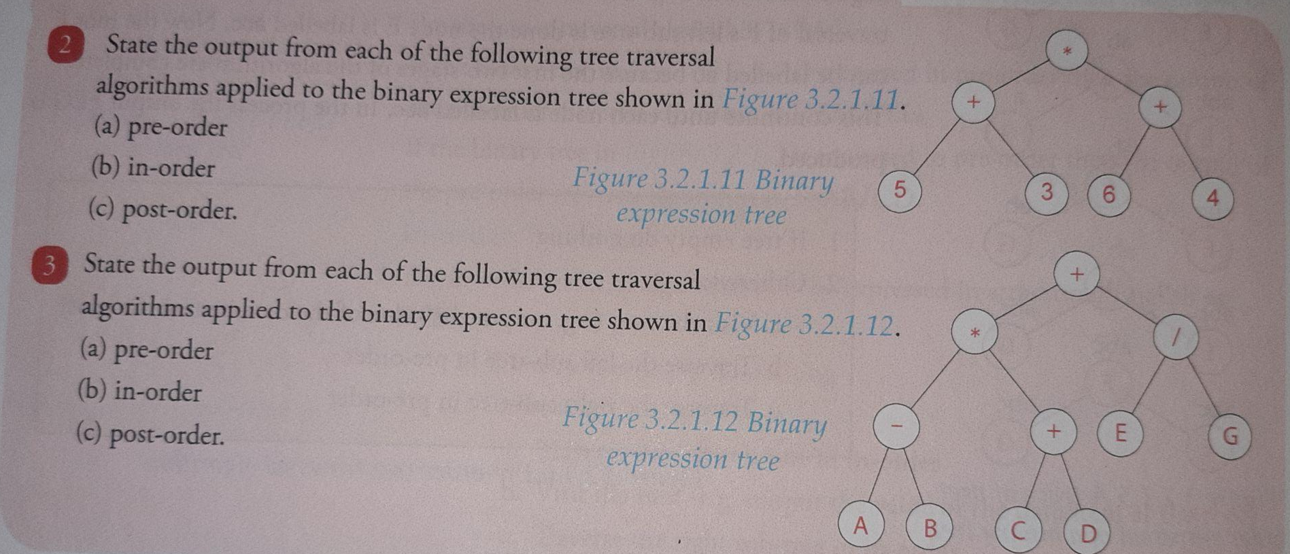
Questions
*+53+64
5+3*6+4 = 27
53+64+*
+*-AB+CD/EG
A-B*C+D+E/G
AB-CD+EG*/+

Slide 19
Vocabulary
Term | Description
Binary tree
Pre-order
In-order
Post-order

Slide 20
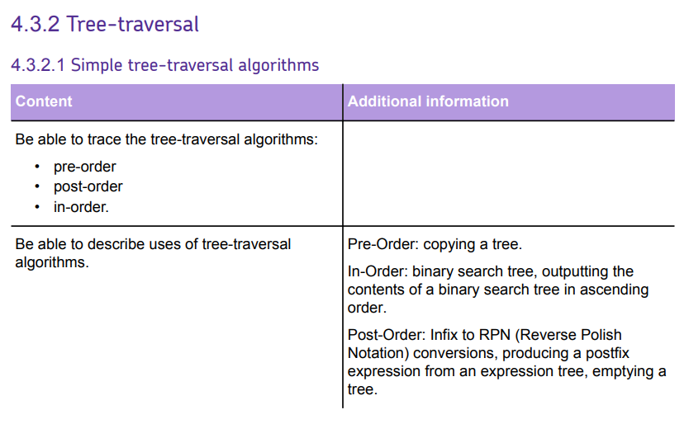

Slide 21




Useful links
Video 1 - Craig N Dave Trees and Binary Trees Youtube video
Video 2 - Craig N Dave Tree-traversal Youtube video
Video 3 - My Code School Binary Tree Traversal Youtube video
Website 1 - Isaac Computer Science website - section on Tree traversal
Video 1 | Video 2 | Playlist 1 | Website 1
Action Plan

